Slide 1
Machine Learning for Optic Correction in the LHC
Alejandro Börjesson Carazo
23/04/2023

Slide 2
Summary
Introduction
Background
Methods
Results
Error simulation
Twiss beta beating
ML Model evaluation
General performance
Performance on different quadrupoles
Conclusion and future improvements
Backup slides

Slide 3
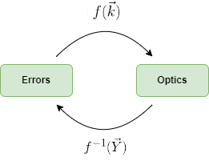
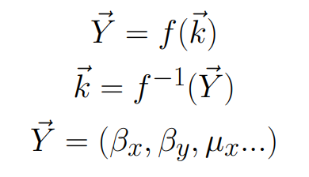
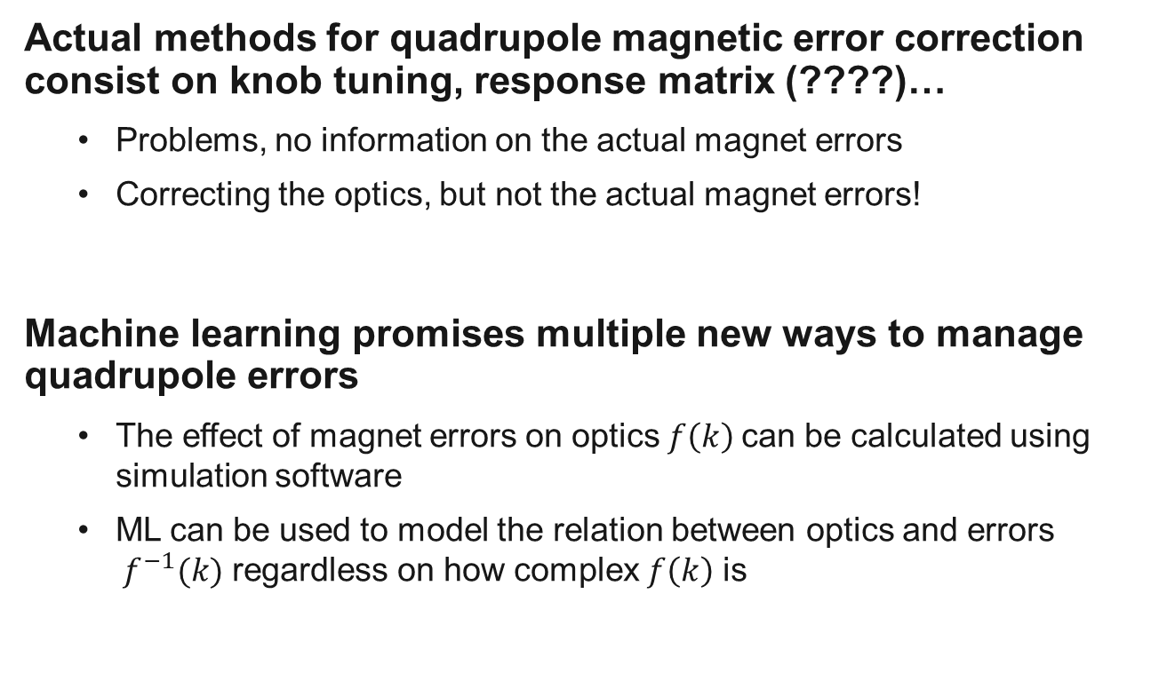
Introduction
Actual methods for quadrupole magnetic error correction consist on knob tuning, response matrix (????)…
Problems, no information on the actual magnet errors
Correcting the optics, but not the actual magnet errors!
Machine learning promises multiple new ways to manage quadrupole errors
The effect of magnet errors on optics$f\left(k\right)$ can be calculated using simulation software
ML can be used to model the relation between optics and errors $f^{−1}(k)$ regardless on how complex $f\left(k\right)$ is

Slide 4
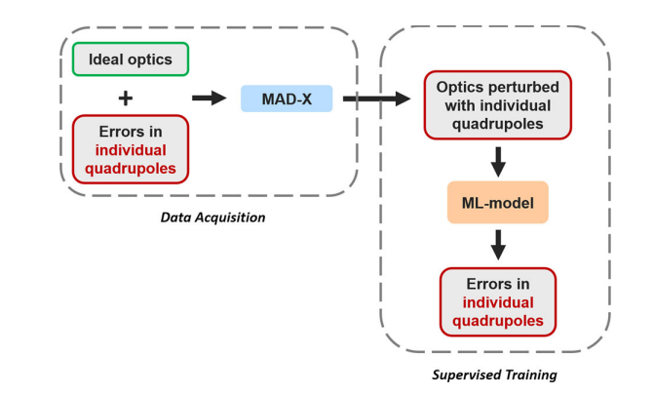

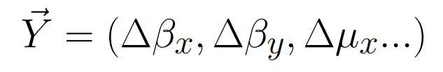
Methods: Data pipeline
Simulating random quadrupole strength errors the corresponding twiss parameters for data generation
Possible improvements to data generation a include using MAD-NG and adding noise
Fig 1. Data pipeline

Slide 5
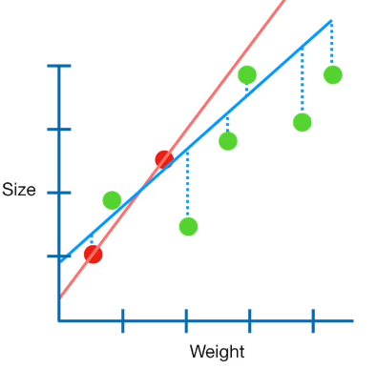
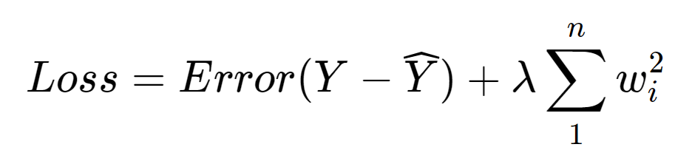
Methods: ML Model
Ridge Regression:
Least squares regression with L2 regularization
Bagging:
Training using ten different subsets of data and averaging the results.
This methods decreases variance of the model and overfitting
Fig 2. Example Ridge regression

Slide 6

Results: Error Simulation
Generating $8 · 10^{4}$ Samples using 2023 30 CM optics.
Fig 2. Example Ridge regression

Slide 7
Table
 | Column 1 | Column 2 | Column 3 | Column 4
Row 1
Row 2
Row 3
Row 4
To help you to give your slides a consistent look, we suggest a basic table style.
It is a good starting point, yet should be adjusted to your needs and space – rows, columns, text size.
You can modify the table options here:
Table Tools > Design

Slide 8
Table
 | Column 1 | Column 2 | Column 3 | Column 4
Row 1
Row 2
Row 3
Row 4
To help you to give your slides a consistent look, we suggest a basic table style.
It is a good starting point, yet should be adjusted to your needs and space – rows, columns, text size.
You can modify the table options here:
Table Tools > Design

Slide 9
References
Fig 1. Data pipeline. "Supervised learning-based reconstruction of magnet errors in circular accelerators" by E. Fol, 2021, https://doi.org/10.1140/epjp/s13360-021-01348-5
Fig 2. Example Ridge regression. “Regularization Part 1: Ridge (L2) Regression" by J. Stamer, 2018, https://www.youtube.com/watch?v=Q81RR3yKn30

